Slide 1
Testing Trip Advisor : online Booking app
made by Horak Orest

Slide 2

Trip Advisor : online Booking app
TripAdvisor is an American travel and restaurant website company that shows hotel and restaurant reviews, accommodation bookings and other travel-related content. It also includes interactive travel forums.
TripAdvisor was founded by Stephen Kaufer, Langley Steinert, Nick Shanny, and Thomas Palka in February 2000.

Slide 3
Functional:
Installation testing
Smoke Testing
Functionality Testing
Non-functional:
Security testing
Usability testing
Localization testing and Internationalization testing
Performance testing
Load testing
Stress testing
GUI testing
Reliability testing
Portability testing
Confirmation testing, Regression testing

Slide 4
Functional testing

Slide 5
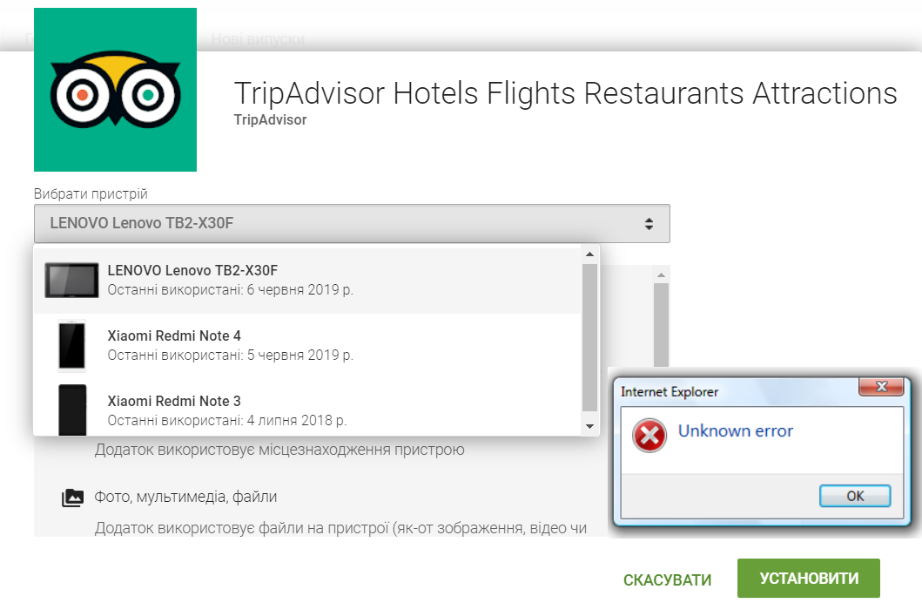
Task: Installation testing.
Testing Procedure: install the program, and verify that it is installed correctly and runs without errors
Defect: during installation, the program revealed unknown errors and the installation stopped
Summary: the installation failed, a unknown error is logged in the error tracking system, the developer team and the project manager are informed about it.

Slide 6
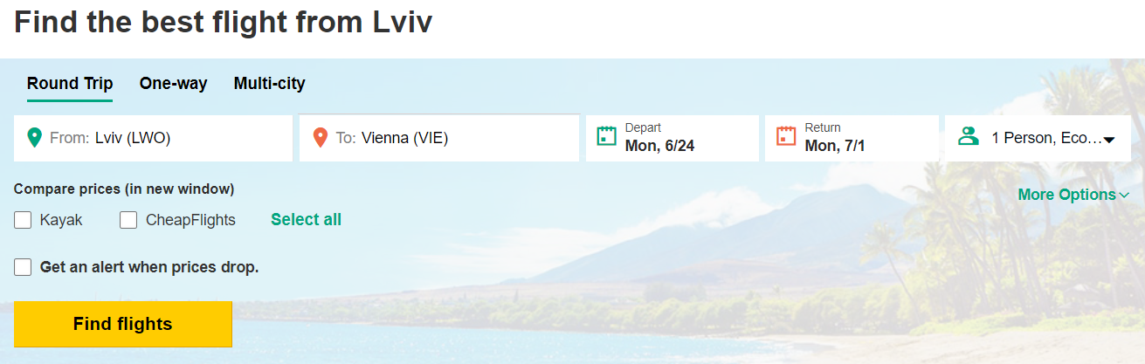
Smoke Testing
Task: Smoke Testing.
Testing Procedure: check whether the main important functions of the program work after the assembly. checking if it can search some flights , things to do , hotels , cruises...etc
Defect: when you search flights department / return date work wrong

Slide 7
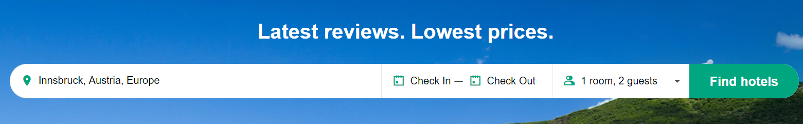
Functional Testing
Task: Testing the program to search hotels
Testing Procedure: check the correctness of the software in accordance with the design specifications, whether all submenus are present, whether the presence of functions described in the specification is present
Defect: the “Find hotels” button doesn’t work

Slide 8
Non-functional testing

Slide 9
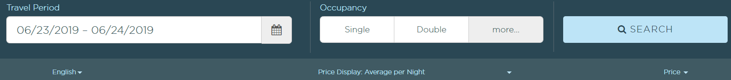
Security testing
Task: check the security of the program when booking hotel
Testing Procedure: we check whether the program is resistant to not correct hotel booking
Defect: we book hotel being unassigned , which led to make wrong booking and lose personal data

Slide 10
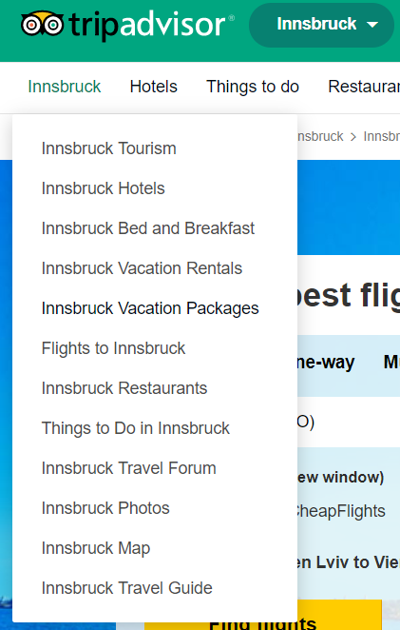
Usability testing
Task: check how fast the users will find the information about city
Testing Procedure: we check how much the program interface is clear and user-friendly and how easy it is to use the main functions.
Defect: such a convenient function as city info is named not clear so its hard to find it

Slide 11
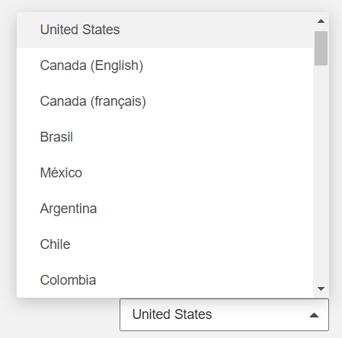
Localization testing and Internationalization testing
Task: check if the program changes the language of the interface when changing the language
Testing Procedure: With this test, we test how the program interface responds to changing the interface language
Defect: when you change the interface language, not all of the added extra features change the language, the wills remain English by default

Slide 12
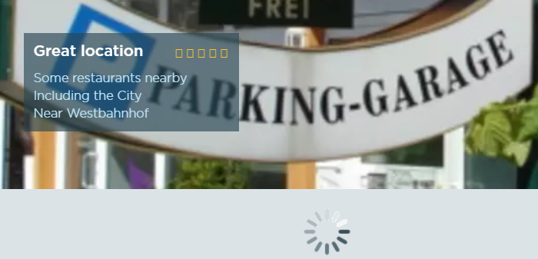
Performance testing
Task: check if the program opens information about hotel
Testing Procedure: check how fast the program will open information about hotel , and we will measure the time how many they open
Defect: the program hangs when you open a information about hotel

Slide 13
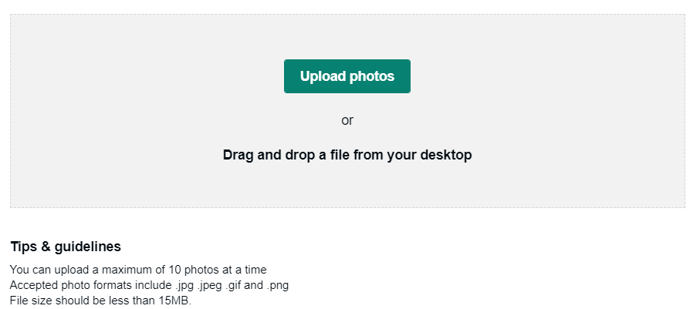
Load testing
Task: check if the program opens a large file.
Testing Procedure: Testing to determine how effectively a product processes different events. How quickly opens files of the declared format
Defect: the program hangs while uploading large files

Slide 14
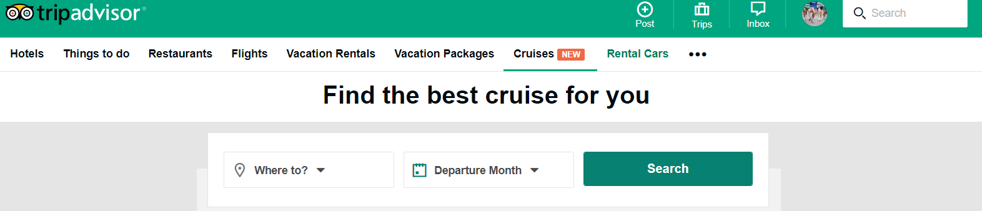
Stress testing
Task: check if the program can withstand the load with a large files
Testing Procedure: check how much the program is stable to open large file, as well as search some details about cruise
Defect: when uploading such a large file, the program showed that the upload was loading, but then it hung

Slide 15
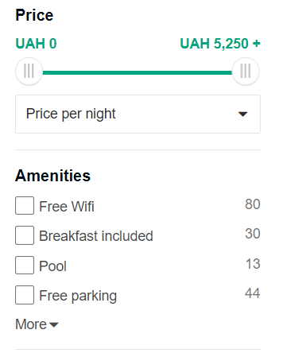
GUI testing
Task: check whether the interface, menu modules and extensions work
Testing Procedure: User Interface testing is done to verify that the application interface to defined standards, also check the convenient and understandable location of the buttons and additional menus
Defect: check buttons aren’t work well in all sections

Slide 16
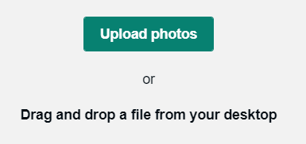
Stability / Reliability Testing
Task: check how the program responds to write revive and upload photos at the same time
Testing Procedure: check how well the program will be reliable and stable at constant load of the system, we will upload files and check whether the program does not hang on writing review
Defect: the review stream freeze from time to time, and then program hang up

Slide 17
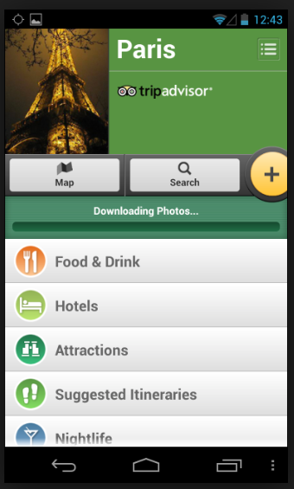
Portability testing
Task: check how the program works on other systems
Testing Procedure: Checks whether the application or software is compatible with the hardware, operating system, database, or other software systems
Defect: after installing the program on an operating system under Android, the program freezes, and does not allow you to do anything

Slide 18
Confirmation testing, Regression testing

Slide 19
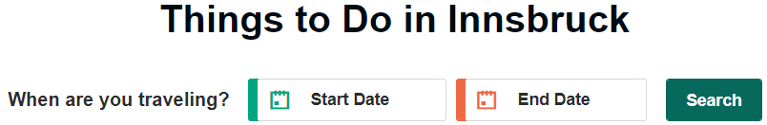
Confirmation testing
Task: test the program after fixing the bugs
Testing Procedure: let's run again tests that have not passed the last time, and now marked as fixed
Defect: after running the tests, most bugs have been fixed, but the some search button bugs has not been fixed in the new build.

Slide 20
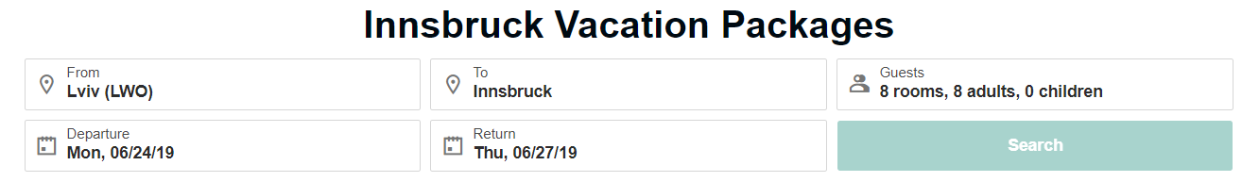
Regression testing
Task: We will make a new assembly and check the main functionality
Testing Procedure: testing of a previously tested program following modification to ensure that defects have not been introduced or uncovered in unchanged areas of the software, as a result of the changes made.
Defect: after making changes all search functions are working well except one

Slide 21
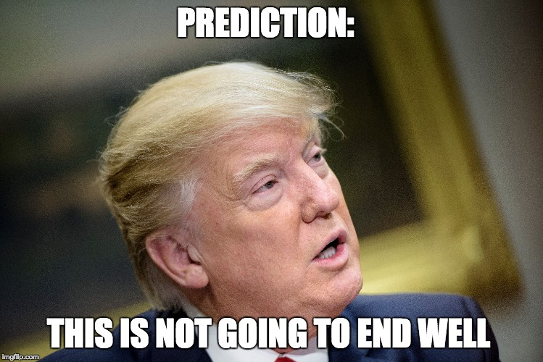

Slide 22


